Slide 1
Ron LeGrand's
Modern Day Money Machine

Slide 2
All slides from this presentation may be downloaded from your Gold Club Membership site www.ronsgoldclub.com under Webinars
If you’re not a Gold Club Member go to www.ronsdollardeal.com and accept my $1.00 offer
Do Not Do It Now

Slide 3
What Is A Modern Day Money Machine?
A method of buying and selling houses by eliminating banks and other costly entanglements to produce frequent five figure checks and monthly residual income with minimal work

Slide 4
The Key Ingredients
Autopilot buying machine
Knowledge of buying and selling with owner financing
A big buyers list and selling system

Slide 5
What Is Seller Financing?
When a sale is made where any part of the sales price becomes a note back to the seller, it is considered seller financing.
When buying you may owe the seller
When selling the buyer owes you
You Become the Bank

Slide 6
But Ron!
I thought the feds outlawed Seller Financing this year!

Slide 7
Good Candidates To Buy With Seller Financing
Free and clear houses (34% are free and clear)
Houses with large equities and a debt
Houses with little or no equity and low payments
Seller Financing Will Not Apply to all your deals. It’s a technique to install in your tool box to use when applicable
or
It can become an entire business model with focus on doing only Seller Financed deals when buying and selling.

Slide 8
Free And Clear House
$200,000 House
Purchase $175,000
Down $ 10,000
Note To Seller $165,000
$1,000 mo.
You Sell $200,000
Down $20,000
Note To You $180,000
$2,000 mo.
Monthly Spread $1,000
$10,000 Net Cash
No Banks
No Contractors
No Private Lenders
No Costly Entanglements
No Delays
No Discounts
Quick Cash
Residual Income
Simultaneous Close
Key- Big Buyers List

Slide 9
Now,
Let's Get In The Big Leagues
And See What Happens
If We Dare To Deal

Slide 10
Free And Clear House
34% of the Market
$200,000 House
Purchase $175,000
Down $ 10,000
Note To Seller $165,000
$1,000 mo.
You Sell $200,000
Down $ 20,000
Note To You $180,000
$2,000 mo.
Monthly Spread $1,000
$10,000 Net Cash
$1,000,000 House
Purchase $900,000
Down $ 25,000
Note To Seller $875,000
$2,500 mo. (0 interest)
You Sell $1,000,000
Down $ 100,000
Note To You $ 900,000
$5,357.28 mo. (6 % Interest – 30 yr.)
Monthly Spread $2,857
$75,000 Net Cash

Slide 11
But Ron!
All sellers won’t sell on installments like your example.

Slide 12
That’s True!
How many do you need in a year?

Slide 13
How Do I Find Free And Clear Houses?

Slide 14
Hi,
My name is John MacNeil and my wife is Donna.
We’d like to buy your house at 123 Maple Street.
Please call me at 555-5496.
John
Yellow
Letter
www.LeGrandYellowLetters.com

Slide 15
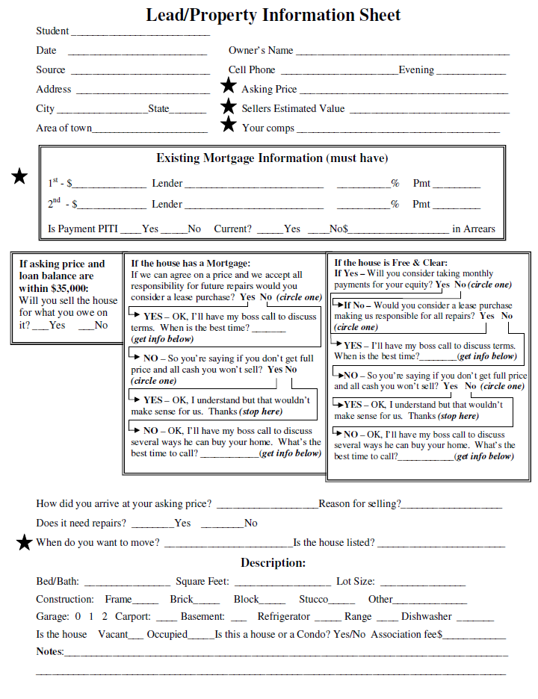

Slide 16
Set up an account with
Patlive.com/RonLeGrand
To Take Inbound Calls

Slide 17
Have a virtual assistant call them back and complete a property info sheet. We can supply your VA
888-840-8389

Slide 18
House With Large Equity And A Debt
$200,000 House
Purchase $175,000
Down $ 10,000
Loan $ 95,000 – $860 mo.
2nd To Seller $70,000 –No payment, No Intrest You Owe $165,000 – $860 mo.
You Sell $200,000
Down $ 20,000
Note To You $180,000 - $1,760 mo.
Monthly Spread $900
$10,000 Net Cash
Profit- 10,000 Down Payment Spread
21,600 Cash Flow ( 2 years)
15,000 When paid off (180,000-165,000)
20,000 Probable discount on Sellers Equity
66,600 Cash- Plus forfeited Down Payments
( Wrap around Mortgage or all inclusive trust deed AITD)

Slide 19
House With Large Equity And A Debt
$200,000 House
Purchase $175,000
Down $ 10,000
Loan $ 95,000 – $860 mo.
2nd To Seller $ 70,000 – NI-NP
You Owe $165,000 – $860 mo.
You Sell $200,000
Down $ 20,000
Note To You $180,000 - $1,760 mo.
Monthly Spread $900
$10,000 Net Cash
$1,000,000 House
Purchase $800,000
Down $ 25,000
Loan $525,000 – $3,800 mo.
2nd To Seller $250,000 – $0 mo.
You Owe $775,000 – $3,800 mo.
You Sell $1,000,000
Down $ 100,000
Note To You $900,000 - $5,357.28 mo.
(6% - 30 yr)
Monthly Spread $1,557.28
$75,000 Net Cash

Slide 20
House With Little Or No Equity
And Low Payment
$200,000 House
Purchase $165,000
Down $ 0
Loan $165,000 – $1,220 mo.
You Buy $165,000 – $1,220 mo.
(Wraparound or Subject to
You Sell $200,000
Down $20,000
Note To You $180,000 - $1,750 mo.
(wraparound, land contract or lease option)
Monthly Spread $530
$20,000 Net Cash
You Can Easily Do Five Of These A Month

Slide 21
House With Little Or No Equity
And Low Payment
$200,000 House
Purchase $165,000
Down $ 0
Loan $165,000 – $1,220 mo.
You Buy $165,000 – $1,220 mo.
(Wraparound or Subject to)
You Sell $200,000
Down $ 20,000
Note To You $180,000 - $1,750 mo.
Monthly Spread $530
$20,000 Net Cash
$1,000,000 House
Purchase $675,000
Down $20,000
Loan $675,000 – $4,500 mo.
You Buy $695,000 – $4,500 mo.
(Wraparound or Subject to)
You Sell $1,000,000
Down $ 100,000
Note To You $900,000 - $5,357.28 mo.
Monthly Spread $857
$100,000 Net Cash
Simultaneous Close
You Need No Money

Slide 22
You Don't Know...
What You Don't Know.
How Much Do You Think What You Don’t Know Has Cost You So Far?

Slide 23
Introducing
Emergency Underground
Boot Camp
Coming Soon

Slide 24
Seller Financing School
How to buy sell houses with Seller Financing and comply with the law and stay out of jail.
Attorney Will Be Present
Mr X Will Keep You Out Of Jail

Slide 25
Seller Financing School
How to use credit repair as a huge buying and selling tool
Why it’s a critical tool to get you cashed out when lease optioning or selling with owner financing
Expert On Site Will Do It For You

Slide 26
Seller Financing School
How to make sellers feel good about leaving the loan in their name and satisfy attorney objections.
How to pull cash out the day you buy.
How to structure offers with no payments or interest and get the seller to gladly accept.
Hot to negotiate big discounts when paying off seller debt and make money than all the profit centers from the deal.

Slide 27
Seller Financing School
How to solve negative cash flow issues and build an empire from monthly cash flow on real estate.
How to sell your houses five times faster than everyone around you by making them easy to buy and building a huge buyers list quickly.

Slide 28
Seller Financing School
How to buy millions in real estate without money or credit and never have debt on your credit report or assets in your name
How to keep almost all the cash you owe the seller when your buyers cash you out. ( Substitution of Collateral)
How to sell as is, do no work and get almost retail value.
How to buy a property at retail price and still make a huge profit

Slide 29
Seller Financing School
How to get big down payments and big monthly payments on almost all your houses.
How to eliminate defaults and pick only the best buyers.
How to sell off incoming payments to get cash for you, pay off underlying debt and show the seller how to do the same to get cashed out when selling to you with owner financing

Slide 30
You’ll Receive A Systems Manual
Scripts for buying and selling
Forms Ron created and copyrighted
Protection Clauses
Agreements Specific to owner Financing
Checklists
Step by step instructions

Slide 31
OK Ron, Give Me The Bad News. What Will It Cost?

Slide 32
Answer
A small piece of your first down payment you receive on a cheap house.
www.ronlegrand.com/sellerfinancing
Or
1-800-567-6128

Slide 33
Less than one House Payment You’ll Needlessly Make On One Vacant House If You Don’t Go.
www.ronlegrand.com/sellerfinancing
Or
1-800-567-6128

Slide 34
Probably About 10% Of What You’ll Lose On Your First Missed Deal Within The Next 30 Days
You will pay for the Training whether you attend or not
www.ronlegrand.com/sellerfinancing

Slide 35
Tuition $2,995
Discounts
Masters -$500
Live Event Attendee -$500
Veterans -$500
Gold Club -$500
My Tuition
3 Equal Payments or save $300 for full payment now
You may bring one guest free
(parent, child, spouse, significant other, staff)
Tax Deductible
Can’t make it to the live event…
You Can Watch Whole Event Online At Same Price
800-567-6128

Slide 36
December 12-14
Jacksonville, FL
Vacation Rental Seminar Following on the 15th
Event Date
www.ronlegrand.com/sellerfinancing
Or
1-800-567-6128

Slide 37
You Have 30 Days To Totally Reverse Your Decision and Receive A Full Refund
Or
You May attend 2 Full Days and Still Receive A Full Refund If You Don’t Feel It Was Worth More Than The Tuition
www.ronlegrand.com/sellerfinancing
Or
1-800-567-6128

Slide 38

Only 100 Admitted
It Will Be Sold Out With A Waiting List

Slide 39
Make Sure You’re Not On It And
Enroll Now!
www.ronlegrand.com/sellerfinancing
Or
1-800-567-6128

Slide 40
Register Now
www.ronlegrand.com/sellerfinancing
Or
Call 1-800-567-6128

